Slide 1
Pan Cancer
Date: 04-05-2024
Instructor: Prof. Amit Sethi, Dep. Of Electrical engineering IIT, Bombay
& Prof. ayan bhattacharya, Dep. of Mathematics, IIT Bombay
-Prajyot Kore, Dep. of Mathematics, IIT, Bombay

Slide 2
Introduction

Slide 3
Problem Statement
Problem: The problem revolves around accurately detecting cancer in whole slide images (WSIs)
Development of Robust models for multi-organs
Examples: In multi-organ cancer detection,
morphological similarities.
Different patterns in different organs

Slide 4
2. Why do we care?
Importance:
- Early detection of cancers, improving patient outcomes and survival
- reduce diagnosis time and enable timely treatment interventions
- difficulty due to variations in tissue appearance and staining
Examples:
Interpreting prostate cancer slides requires discerning between benign prostatic hyperplasia (BPH) and malignant tissue
- can have overlapping features.
- distinguishing between different subtypes of breast cancer based on histological

Slide 5
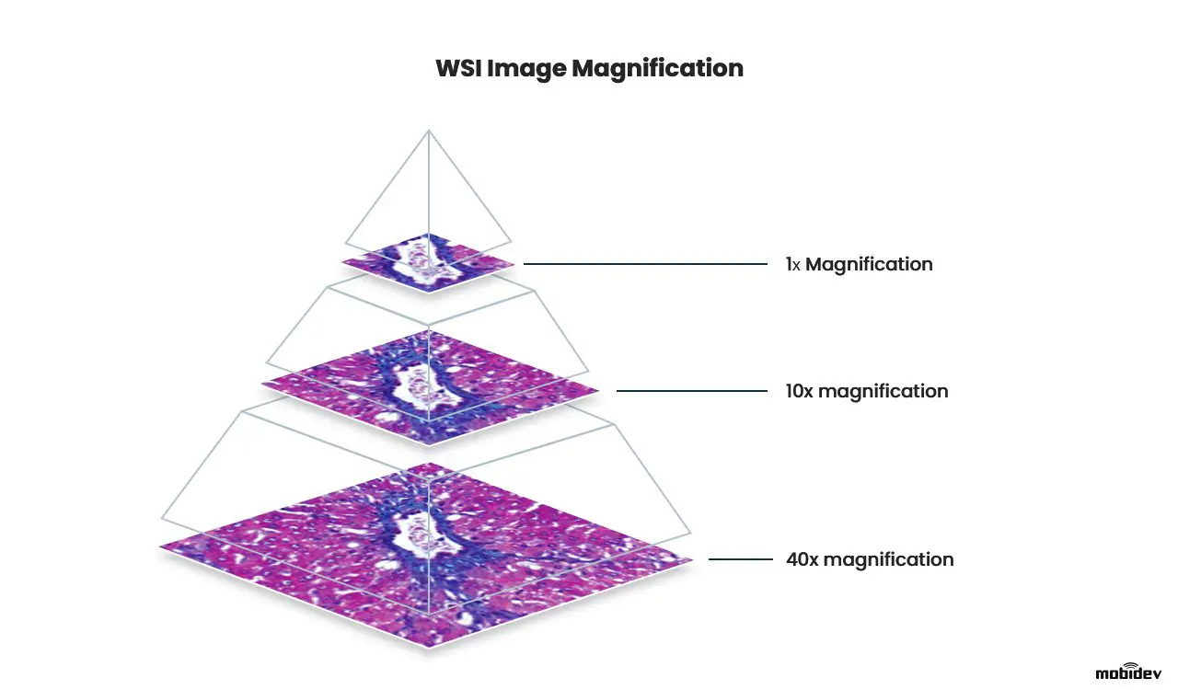
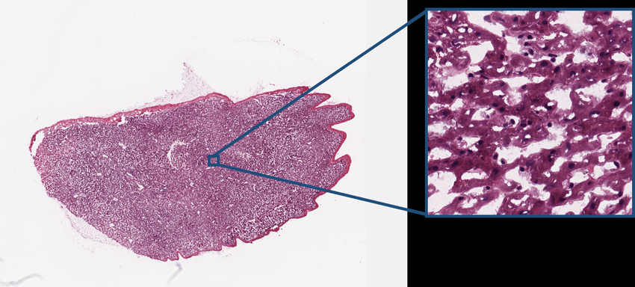
What is WSI?
Whole Slide Imaging (WSI)
Involves digitally scanning a tissue slide
As high as 100000*100000 resolution
Different levels of magnification eg. 40x
Large information, patterns
Pyramid structure
Image source:How AI Helps in Whole Slide Images Analysis for Cancer Detection (mobidev.biz)

Slide 6
Dataset and preprocessing

Slide 7
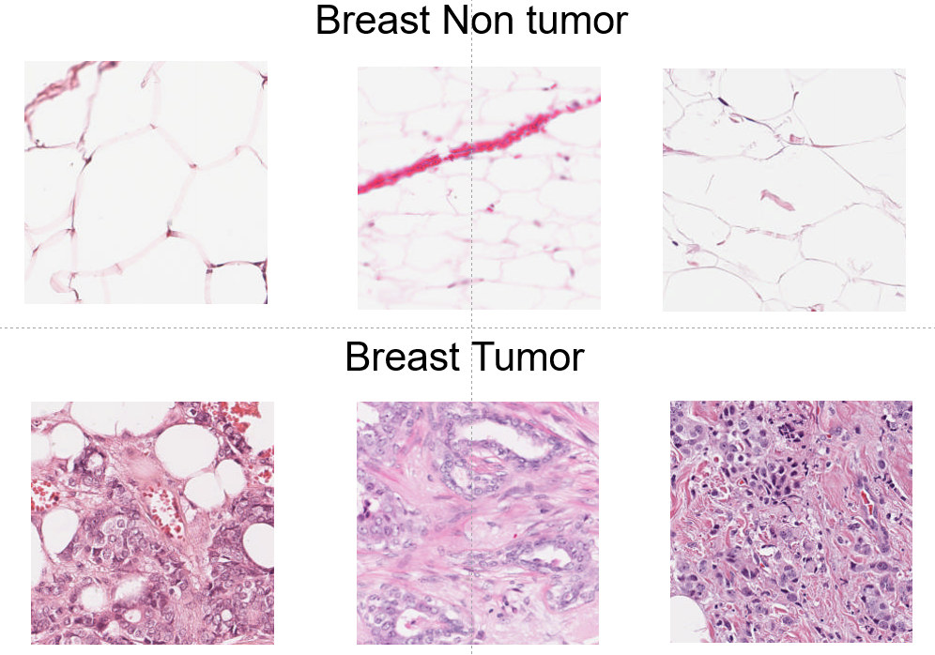
Dataset and Preprocessing:
Sample patches from Breast
4 organs, colon, breast, thyroid and prostate
4 slides per organ
3:1 training to testing ratio
Extracted patches with tumor/ non-tumor labels
Challenges:
High resolution
Model selection
Hyperparameter tuning
Overfitting and generalization
Data quality

Slide 8
methodology

Slide 9
Main Idea:
Different architecture
Unbalanced to balanced dataloader
Tested on multiple organs
Hyperparameter tuning

Slide 10
Different Architectures
- MobileNet v3 Small
- KimiaNet
- Also Tested MobileNet v2, DEnseNet

Slide 11
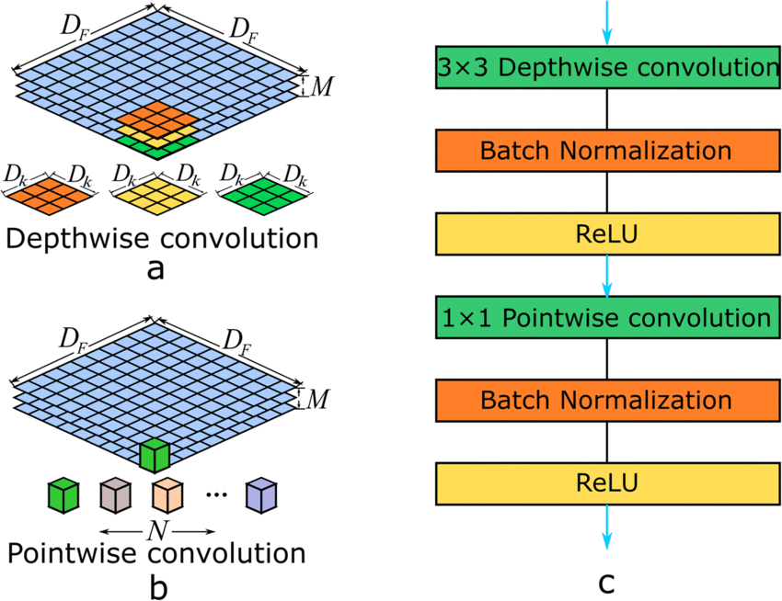
1. MObileNet-v3-small
light weighted models
State of Art Performance
Have only few millions of parameters
source:Mobilenet F0B (mungfali.com)

Slide 12
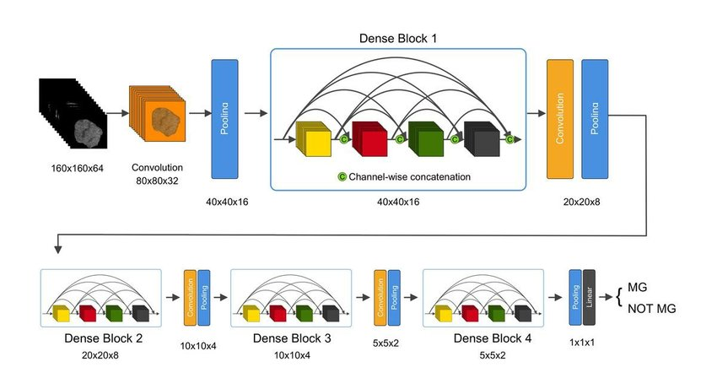
2. KimiaNet
Topology of DenseNet
Requires fewer parameters
Pre-Trained on more than 240000 histopathological images
source:An illustration of the architecture of our 3D DenseNet deep learning... | Download Scientific Diagram (researchgate.net)

Slide 13
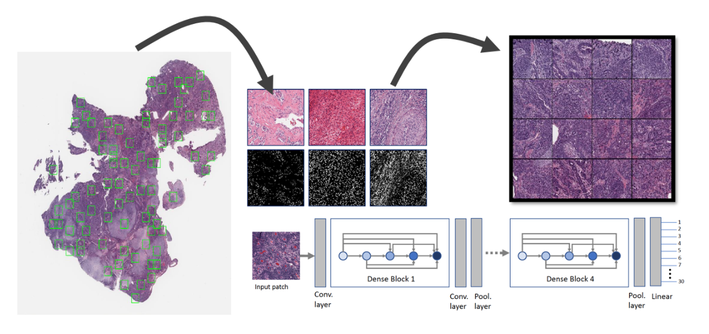
KimiaNet Architecture

Slide 14
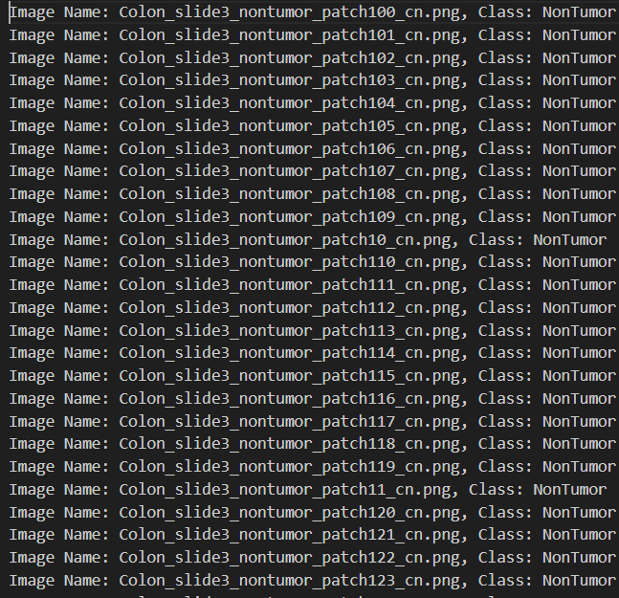
Unbalanced
Data loader
Only considering samples from few slides but not all
Unrandom fashion

Slide 15
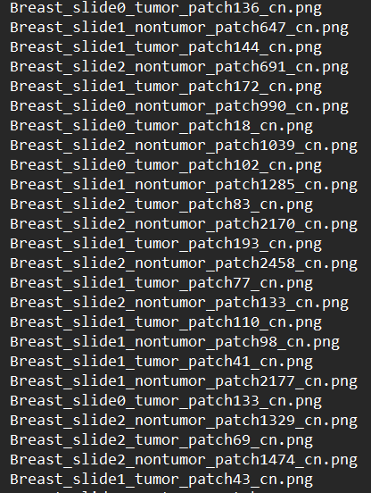
2. Balanced Data Loader
Samples from all the slides
Random Fashion

Slide 16
3. Hyperparameters
lr rate: 1e-7 to 1e-2
Trainable layers: 0 to 4
Dropout: 0 to 0.5
Weight decay: 1e-5

Slide 17
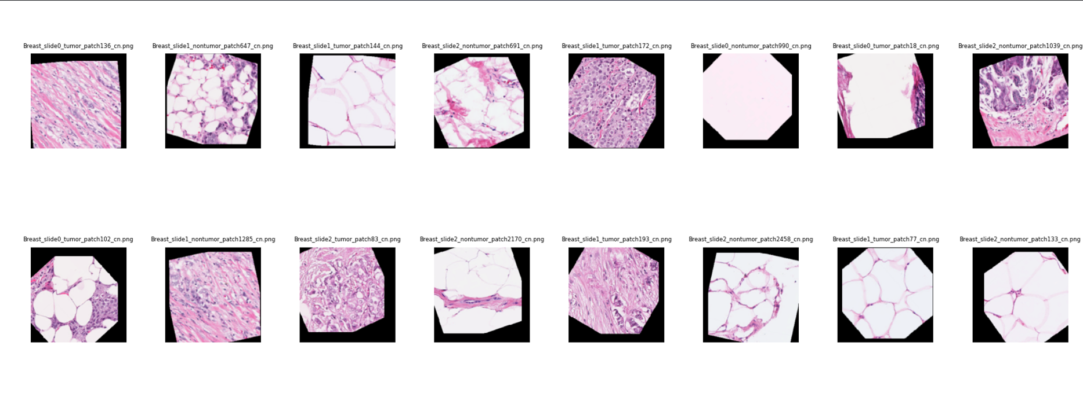
Samples from balanced dataloader

Slide 18
Results?

Slide 19
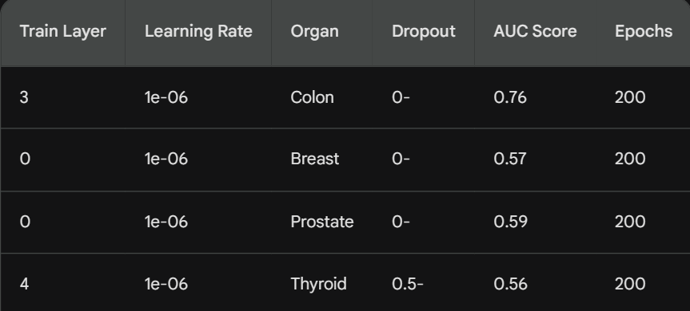
KimiaNet without balanced dataloader results

Slide 20
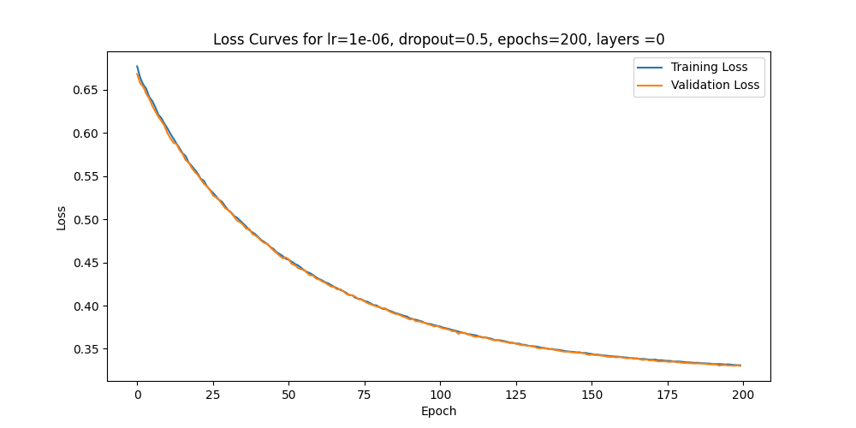
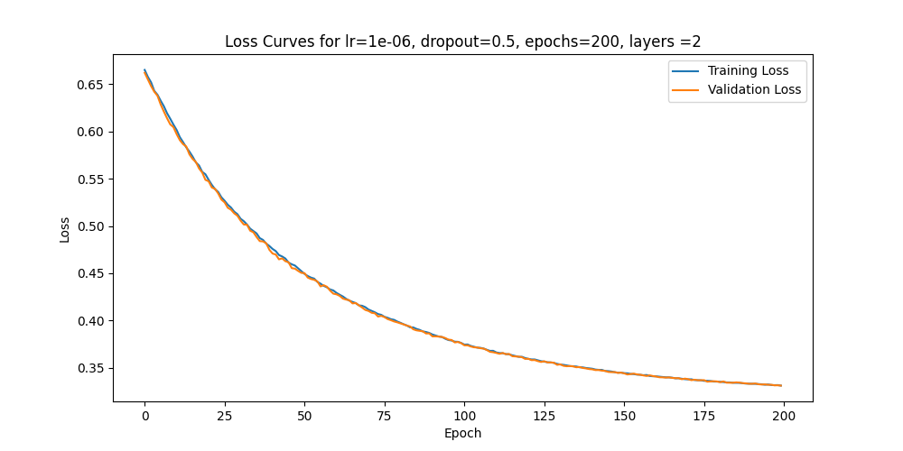
Loss curves for KimiaNet Breast

Slide 21
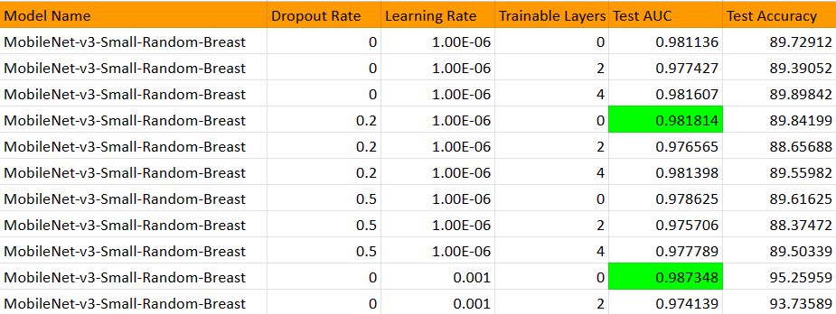
Mobilenet Using balanced data loader for breast

Slide 22
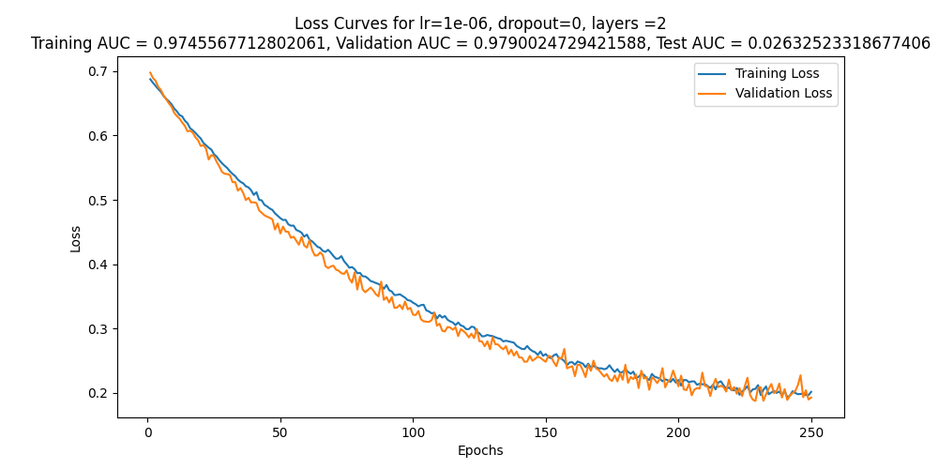
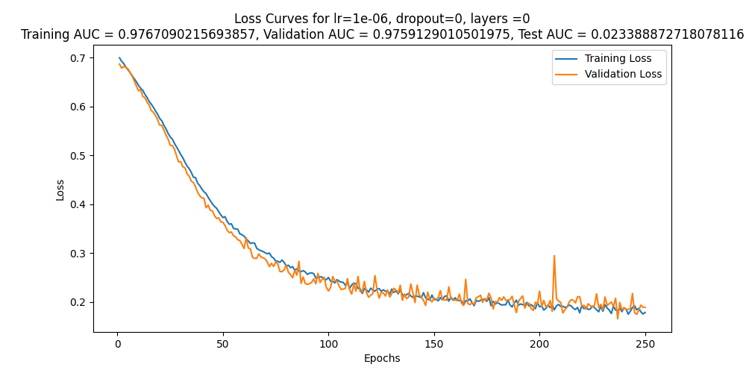
MobileNet-v3-Small for Breast

Slide 23
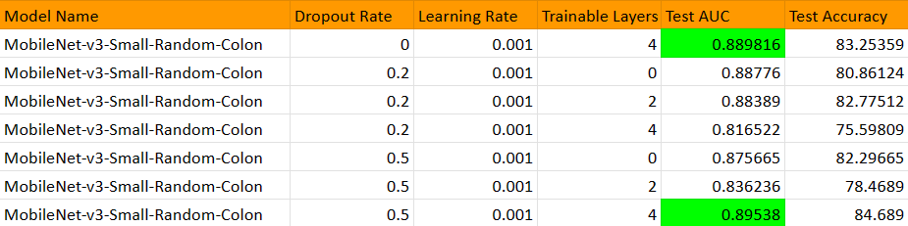
Mobilenet Using balanced data loader for breast

Slide 24
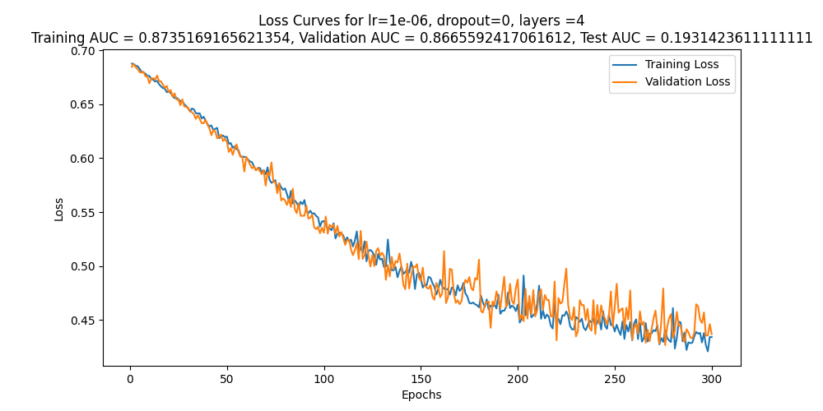
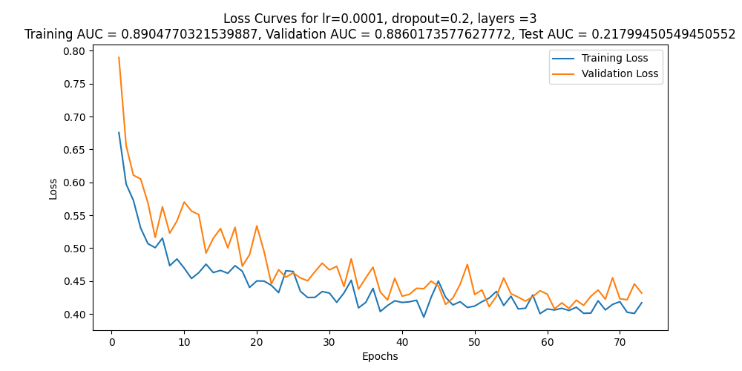
MobileNet-v3-Small for Colon

Slide 25
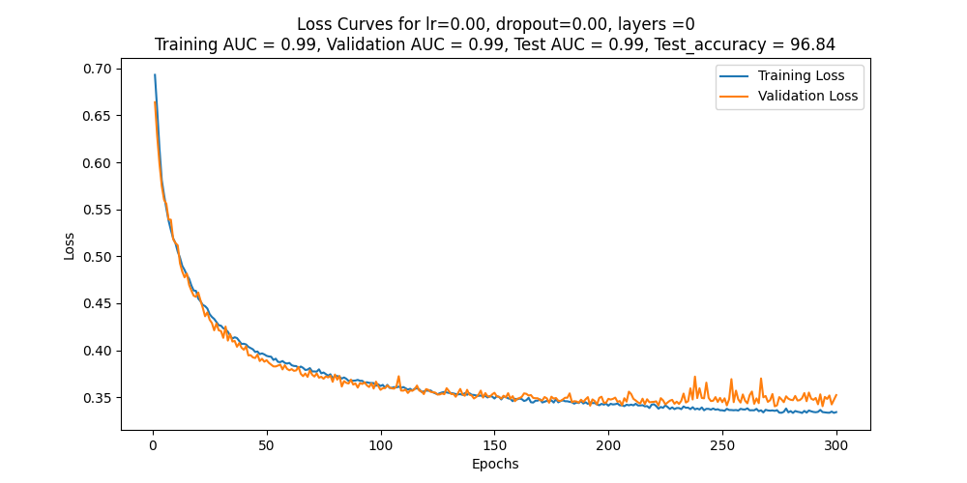
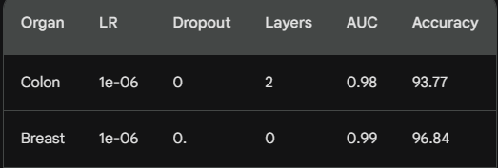
KimiaNet-Regularized-Balanced with weight-decay = 1e-5

Slide 26
Multiorgan testing

Slide 27
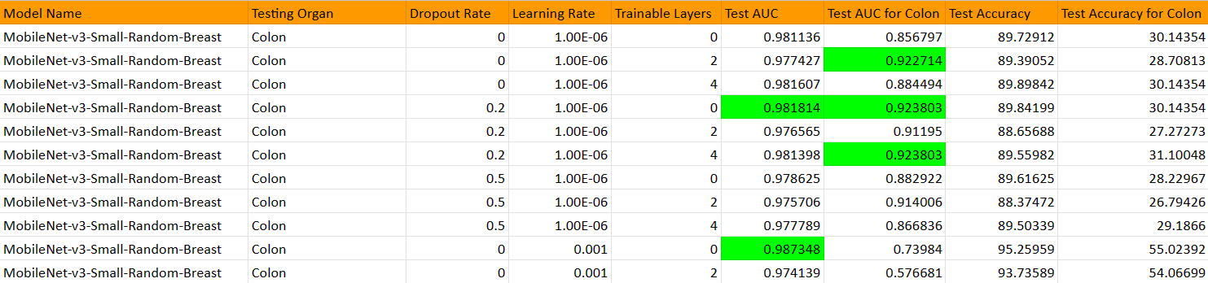
Testing mobilenet trained on breast on colon

Slide 28
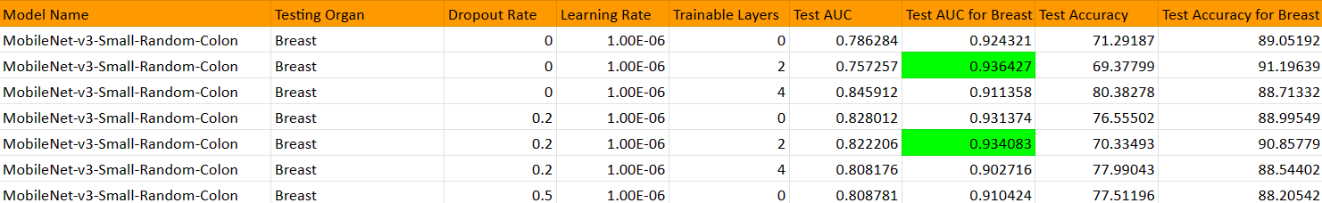
Testing mobilenet trained on colon on breast

Slide 29
Further research
-k-fold cross validation
- using optimization tools, eg. optuna
- multiorgan training

Slide 30
References:
Fine-Tuning and Training of DenseNet for Histopathology Image Representation Using TCGA Diagnostic Slides
Deep Features for Tissue-Fold Detection in Histopathology Images
Densely Connected Convolutional Networks

